Slide 1
Fun with Filters and Frequencies!
CV Project 2

Slide 2
Part 1: Filters
Finite Difference Operator
Derivative of Gaussian (DoG) Filter

Slide 3
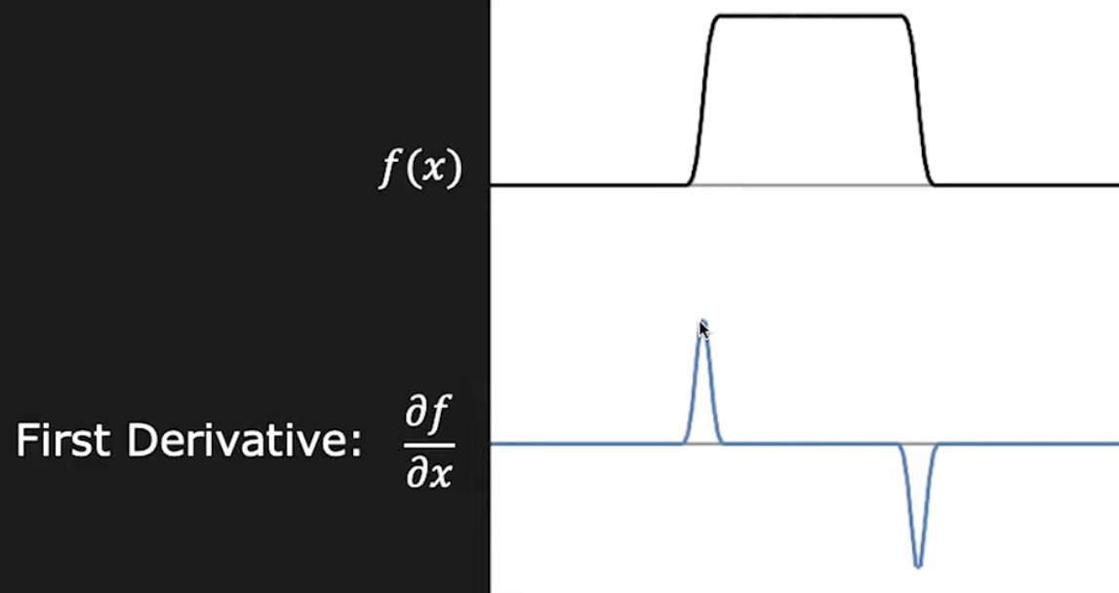
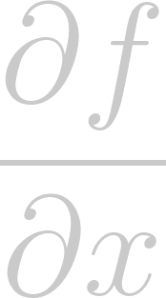
Part 1.1: Finite Difference Operator
1D Edge Detection:

Slide 4
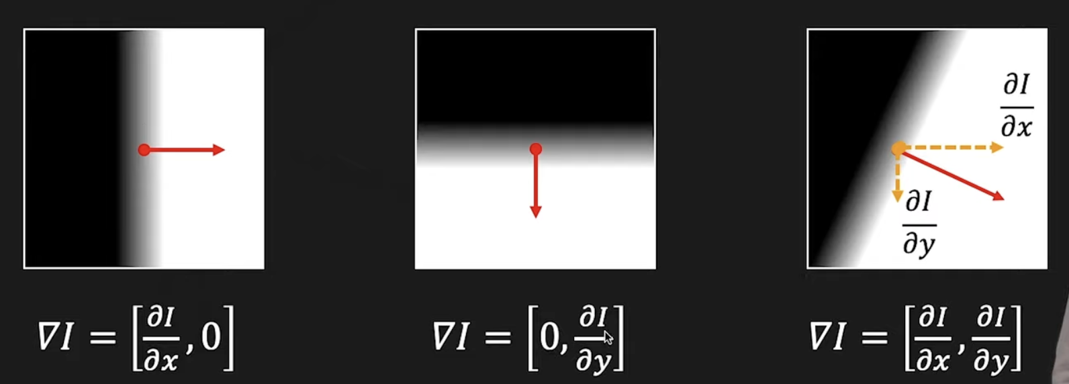
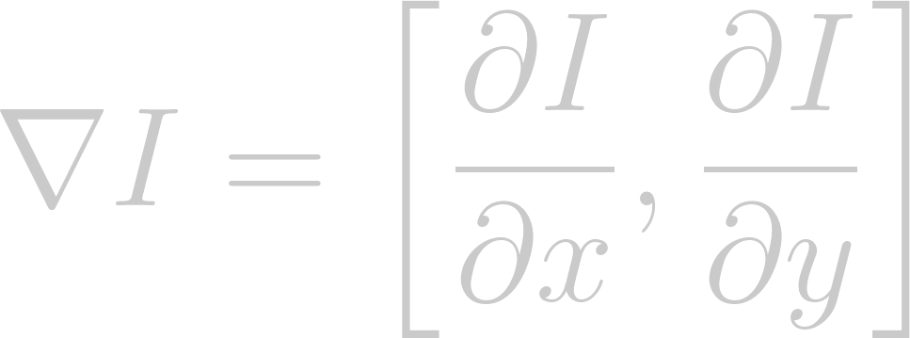
Part 1.1: Finite Difference Operator
2D Edge Detection:

Slide 5
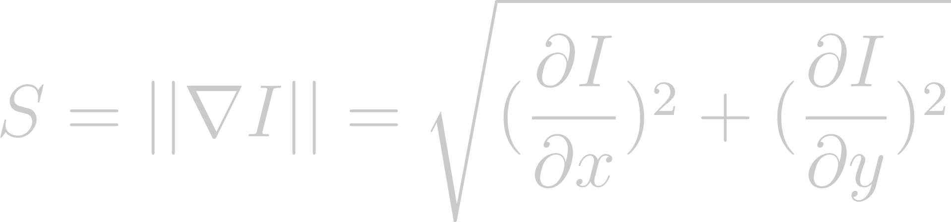
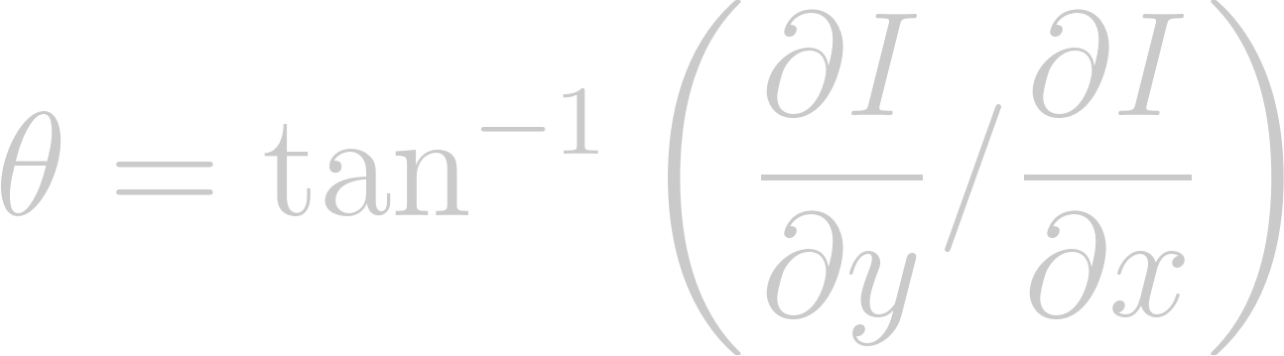
Part 1.1: Finite Difference Operator
Gradient Magnitude:
Gradient Orientation:

Slide 6
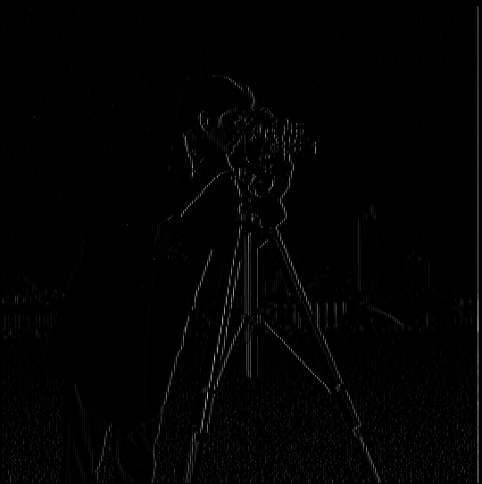

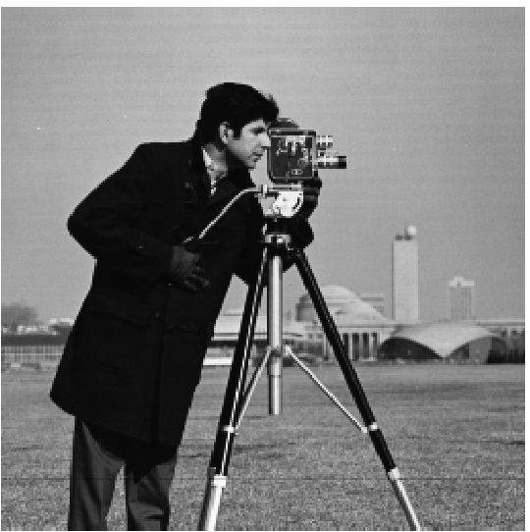
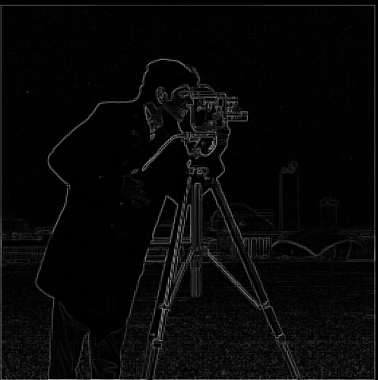
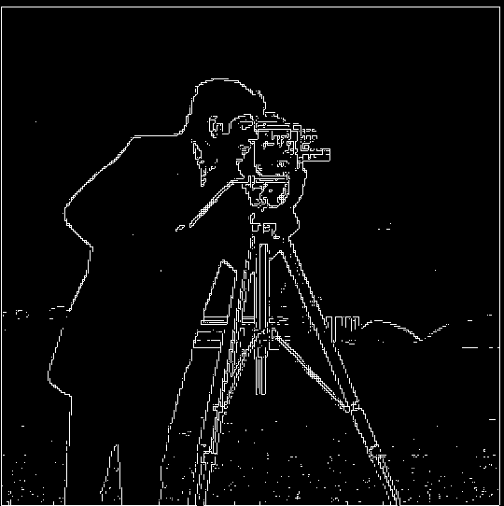

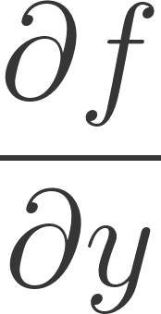
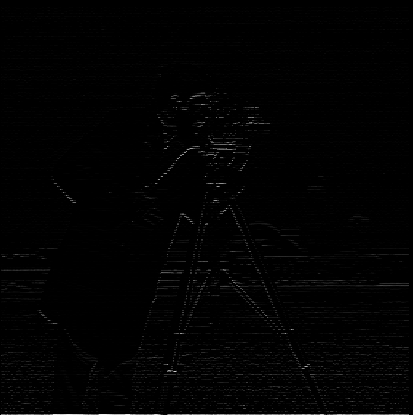
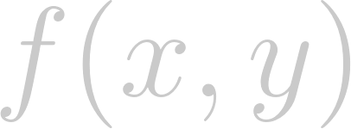
Gradient X
Input Image
Gradient Magnitude
Binarized
Gradient Y

Slide 7
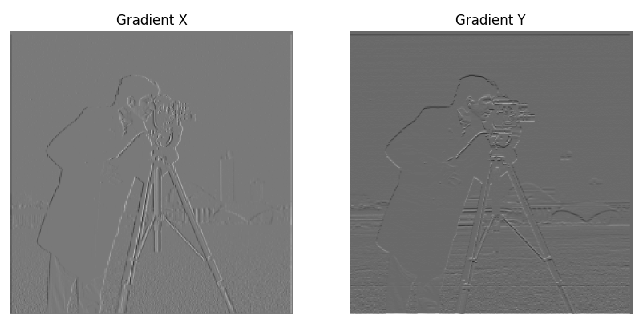
Part 1.1: Finite Difference Operator

Slide 8
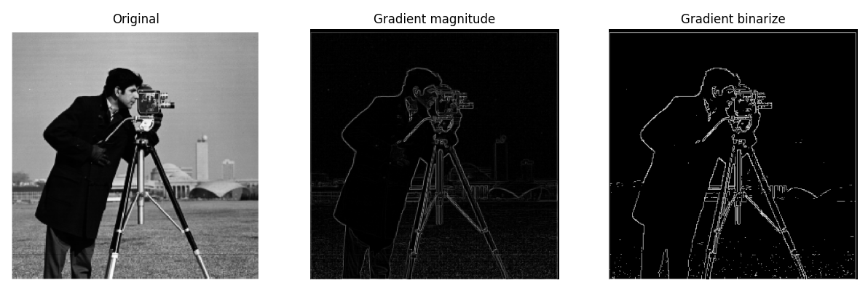
Part 1.1: Finite Difference Operator

Slide 9
Effect of Noise

Slide 10
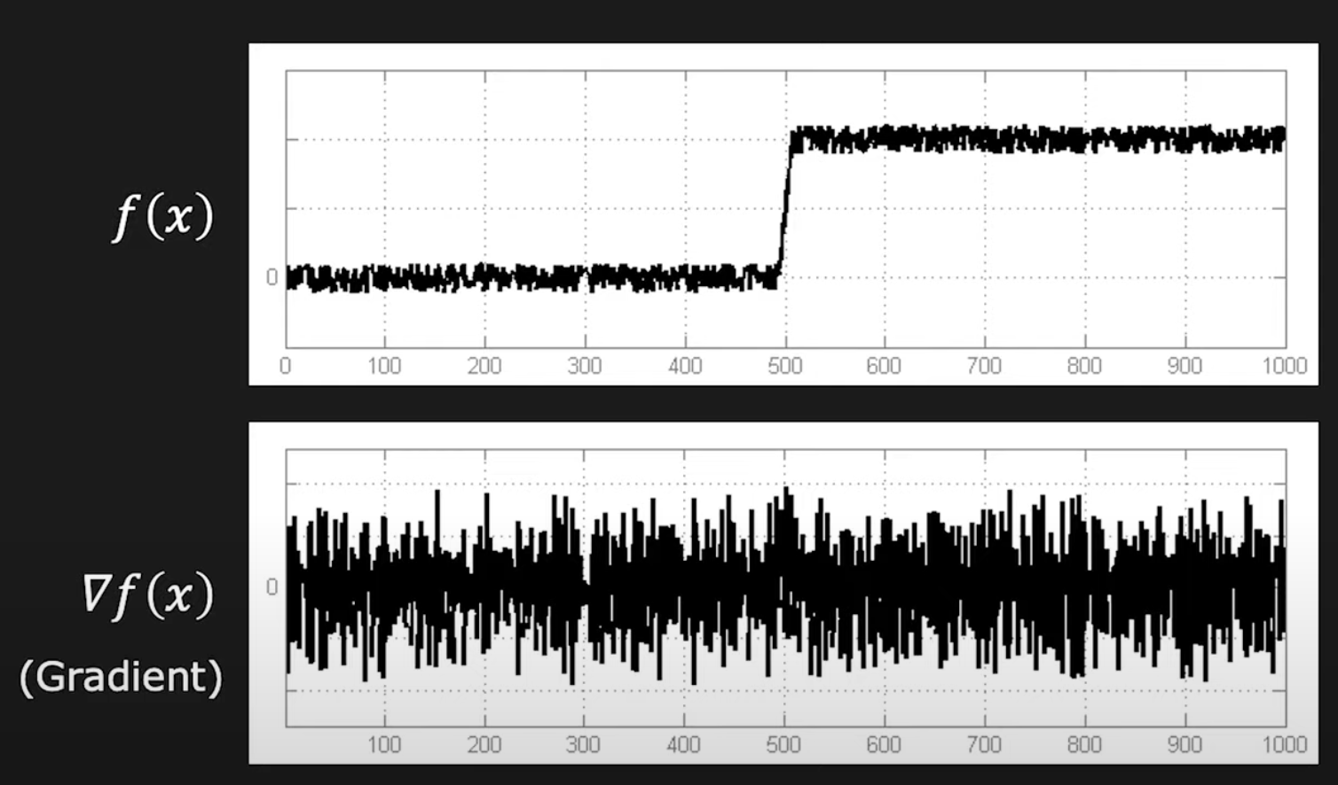
Effect of Noise

Slide 11
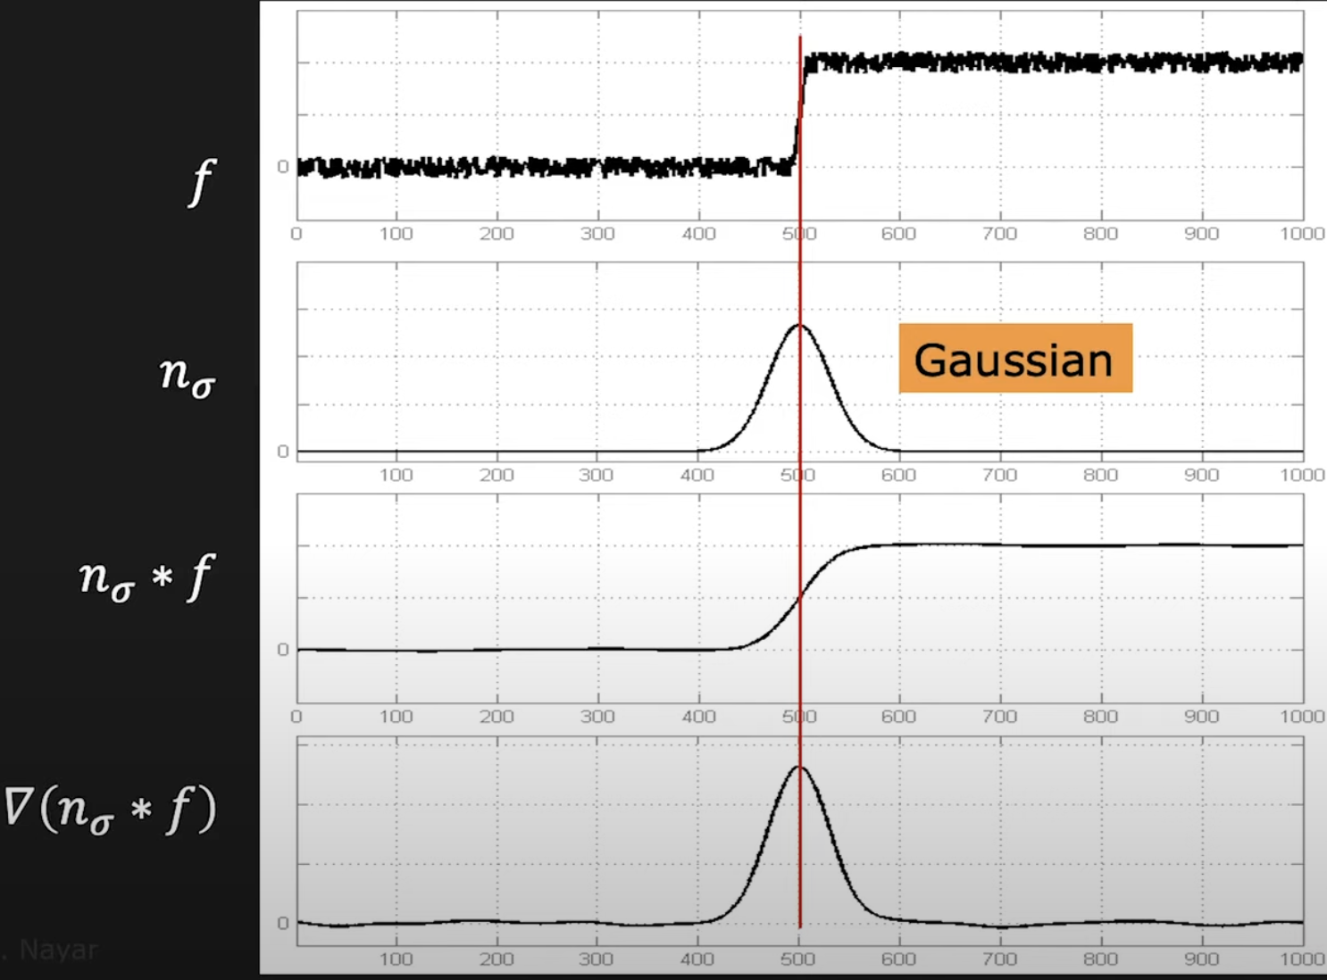
Solution: Gaussian Smooth

Slide 12
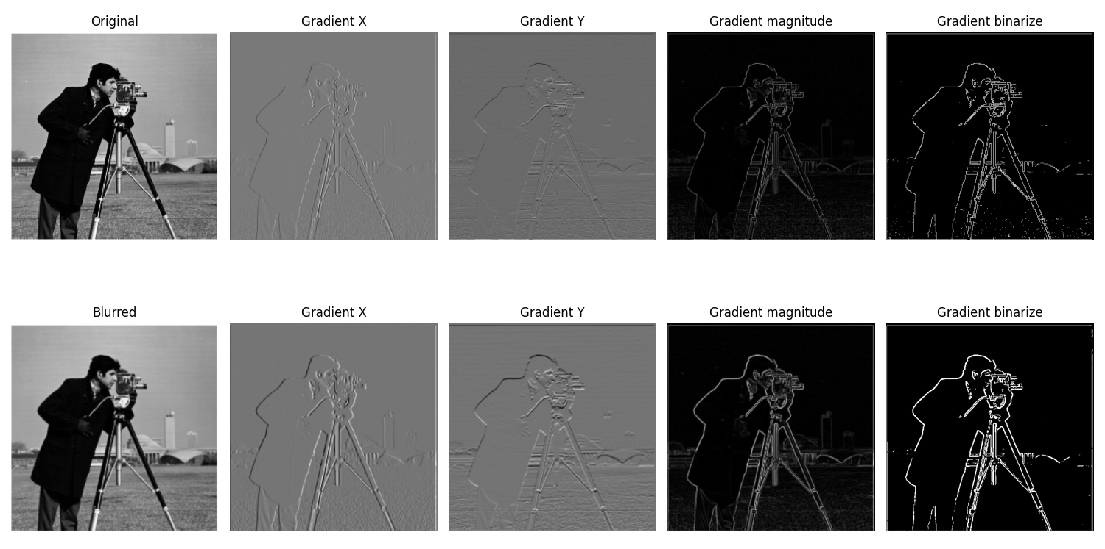
Part 1.2: Derivative of Gaussian (DoG) Filter

Slide 13
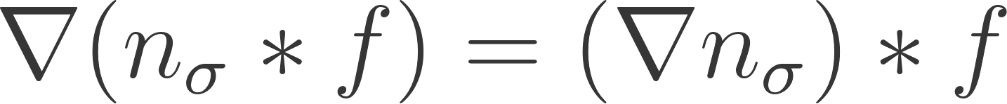


Part 1.2: Derivative of Gaussian (DoG) Filter
: Image
: Gaussian Filter
: DoG Filter

Slide 14
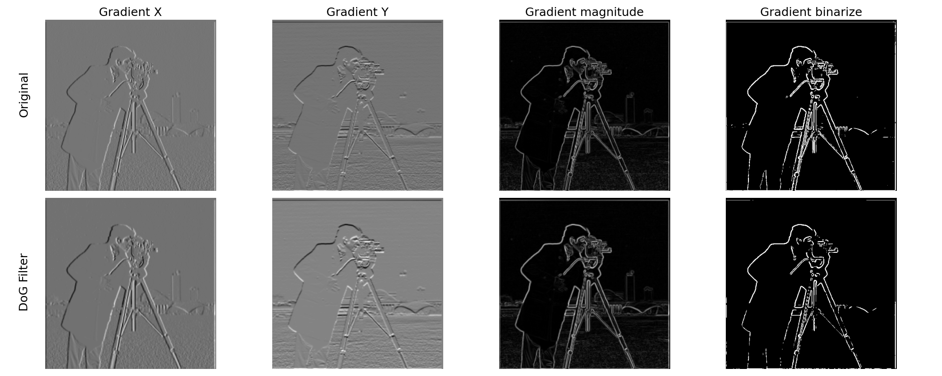
Part 1.2: Derivative of Gaussian (DoG) Filter

Slide 15
Part 2: Frequency
Image Sharpening
Hybrid Images
Gaussian and Laplacian Stacks
Multiresolution Blending

Slide 16
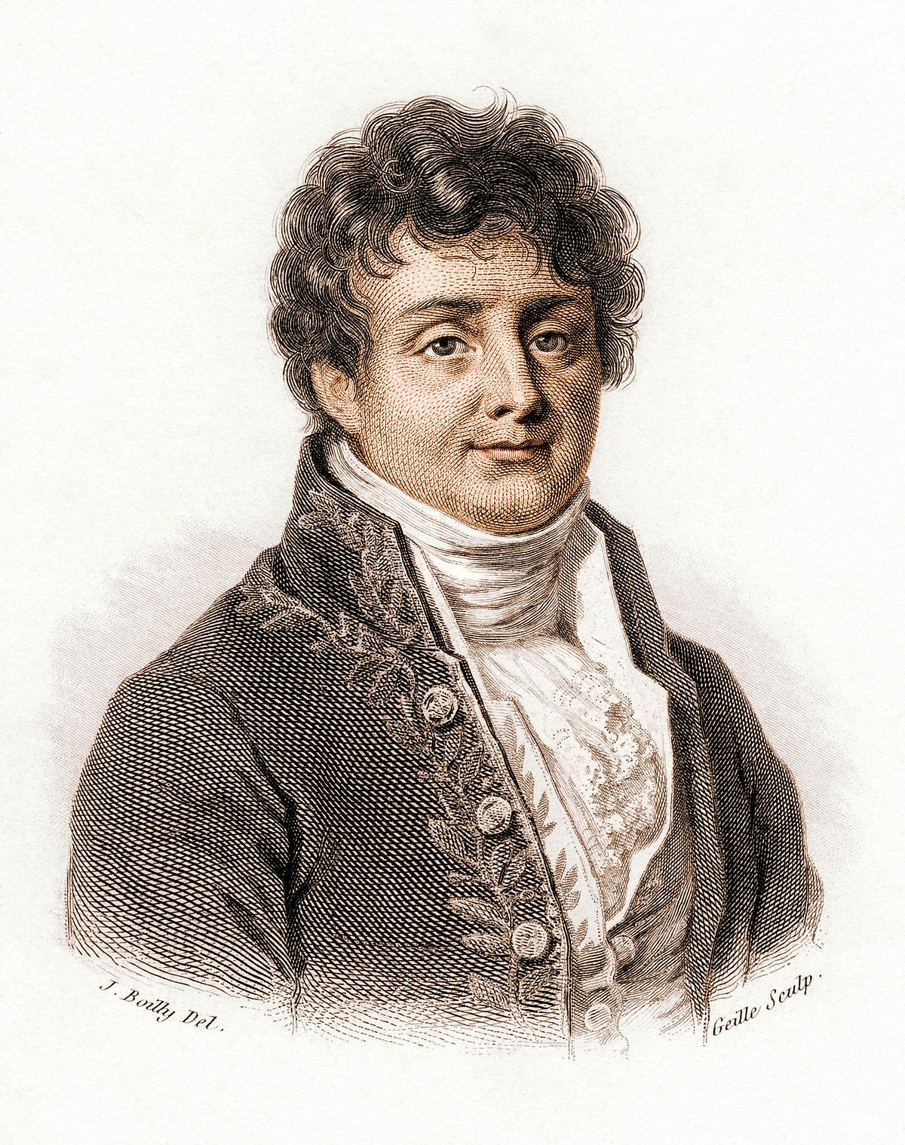

Fourier Transform
“ Any signal f(x) can be represented in terms of amplitudes and phases of its constituent sinusoids. ”

Slide 17
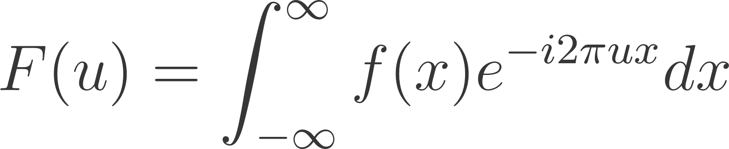

Fourier Transform
x: space
u: frequency

Slide 18
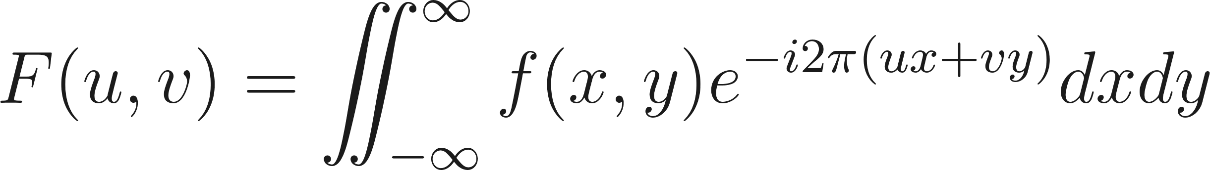
2D Fourier Transform
x, y : space
u, v : frequency along x, y

Slide 19
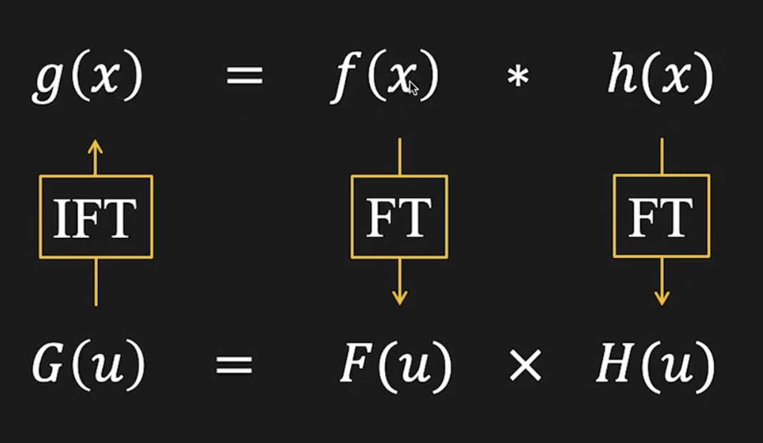
Convolution by Fourier Transform

Slide 20
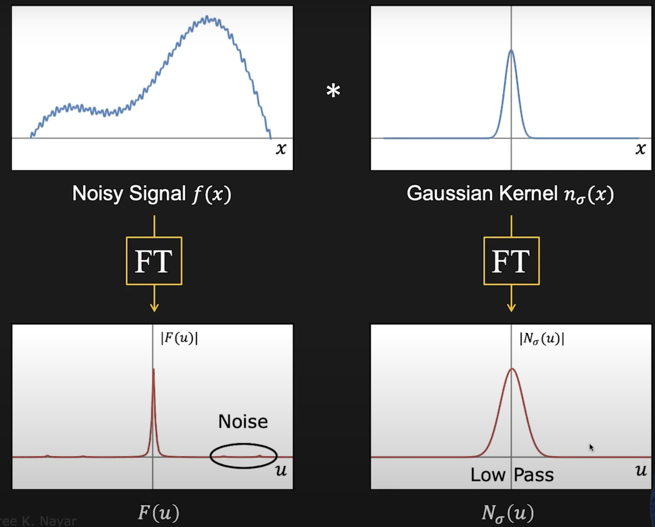
Frequency Domain

Slide 21
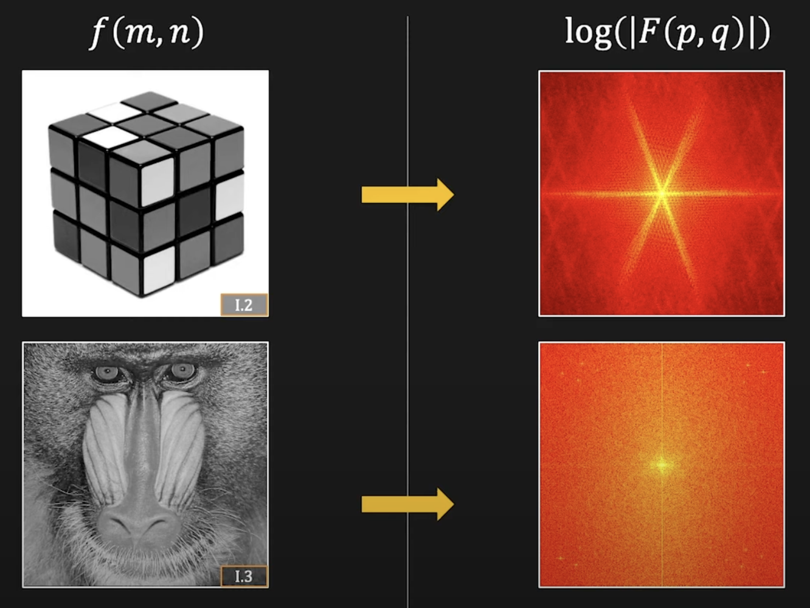
Frequency Domain

Slide 22
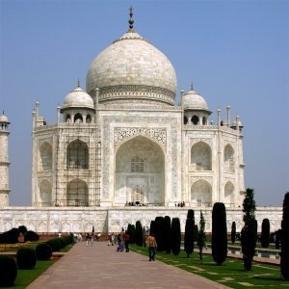

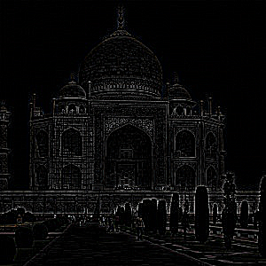

Part 2.1: Image Sharpening
Original
Blurred
(Low Frequency)
Detail
(High Frequency)

Slide 23
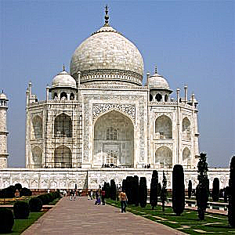

Part 2.1: Image Sharpening
Original
Detail
(High Frequency)
Sharpened

Slide 24
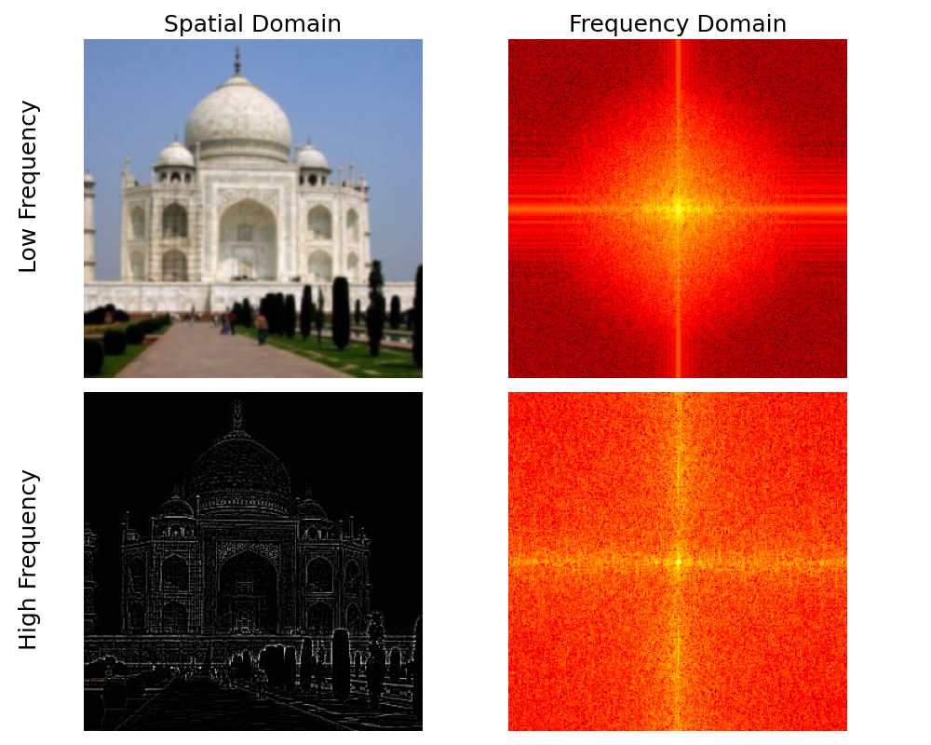
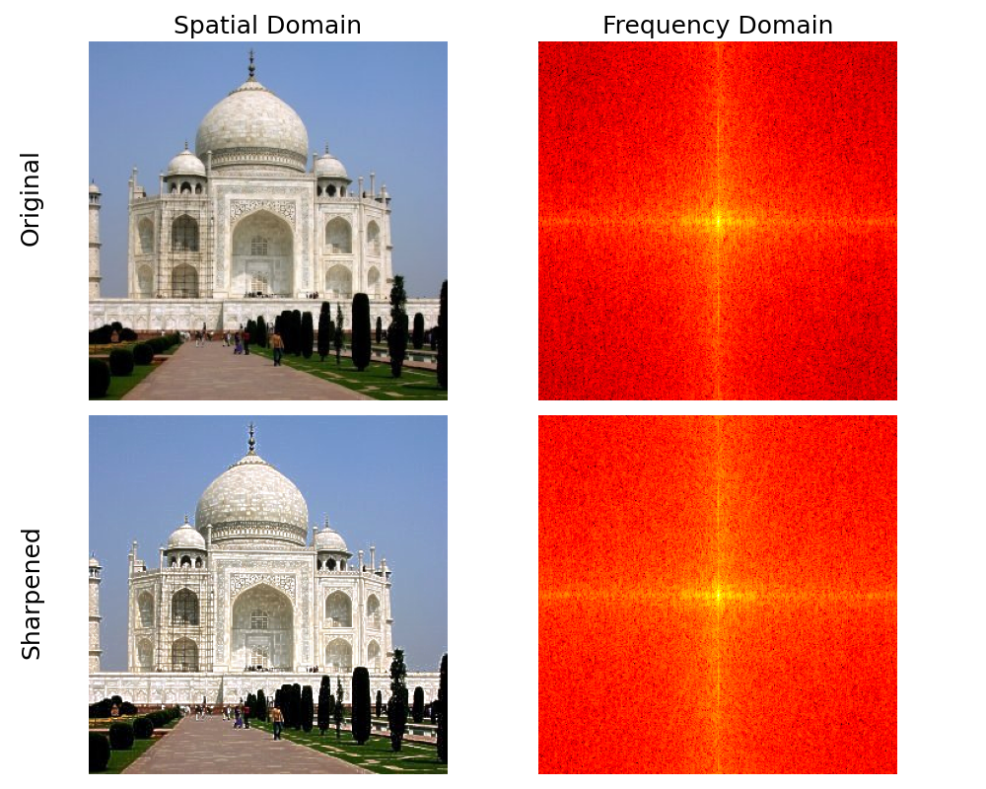
Part 2.1: Image Sharpening

Slide 25
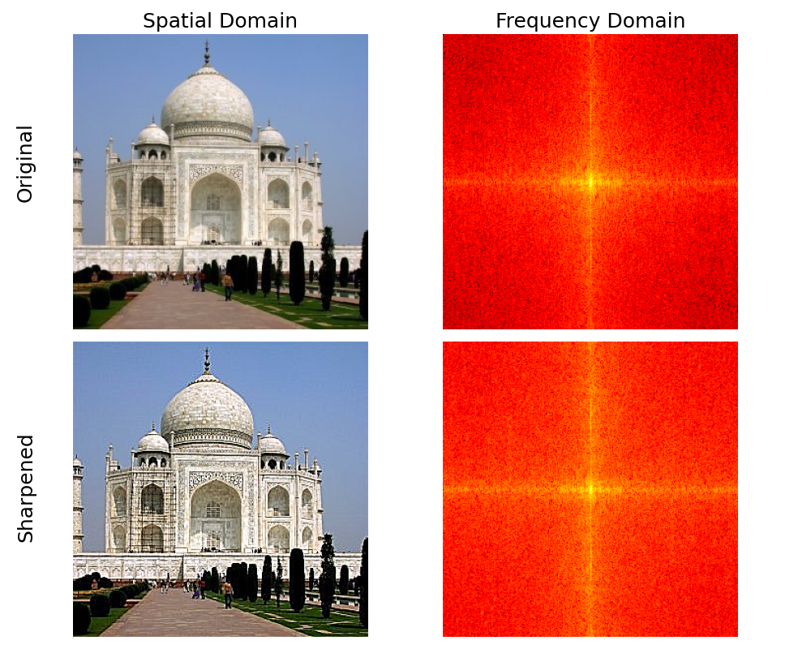
Part 2.1: Image Sharpening

Slide 26
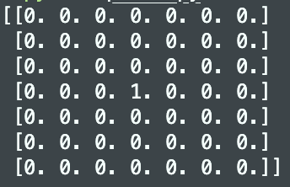
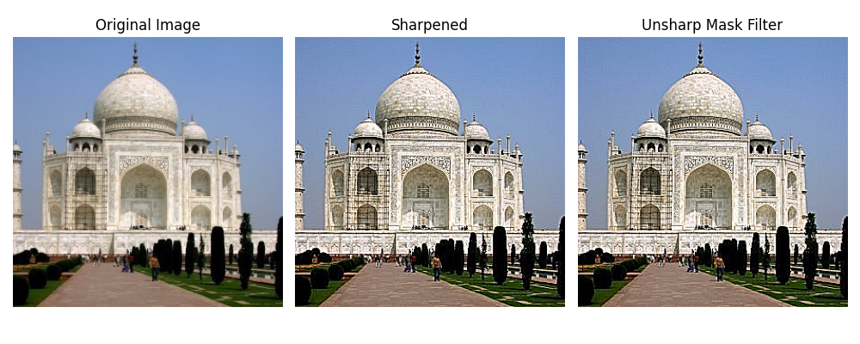
Part 2.1: Image Sharpening
scipy.signal.unit_impulse
Unsharp Mask Filter

Slide 27
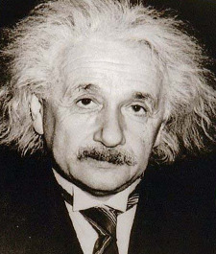
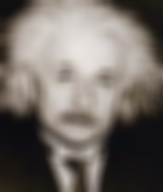
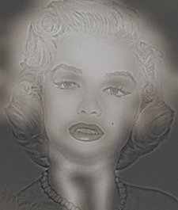

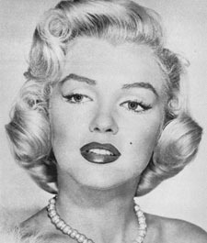
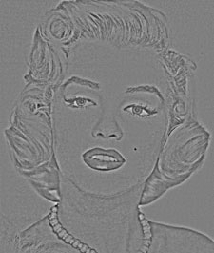


Part 2.2: Hybrid Images
Lowpass
Highpass
Hybrid

Slide 28
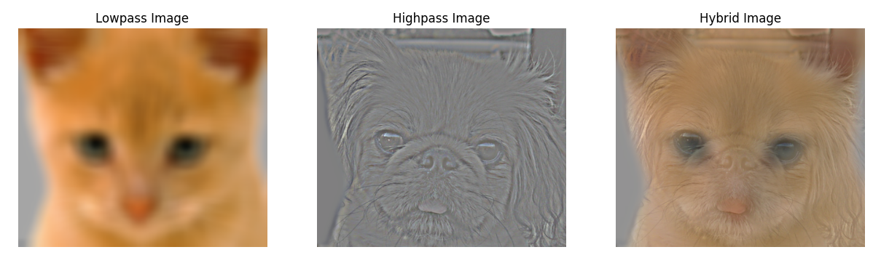
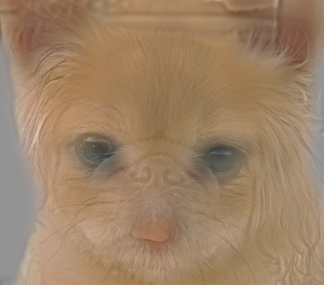
Part 2.2: Hybrid Images

Slide 29
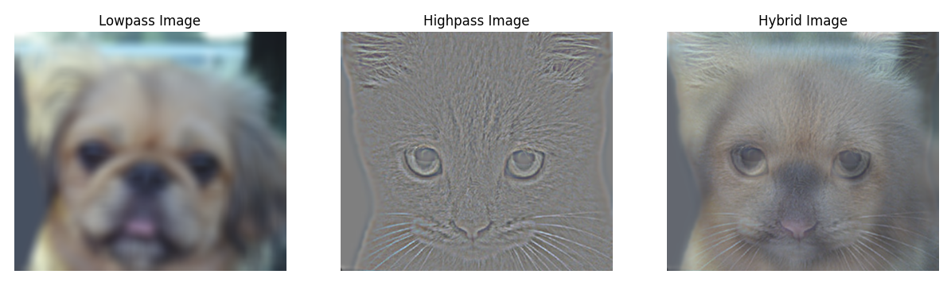
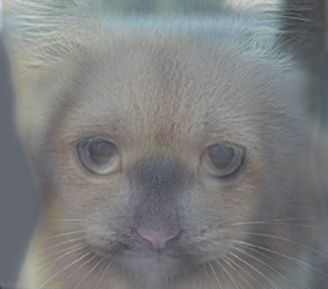
Part 2.2: Hybrid Images

Slide 30
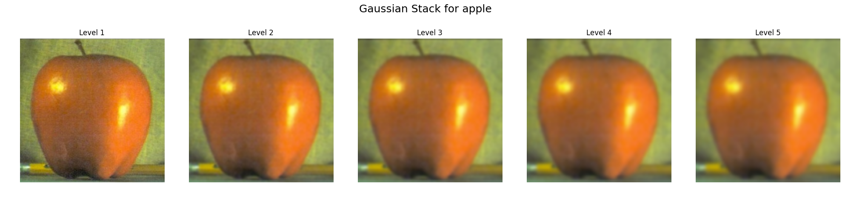
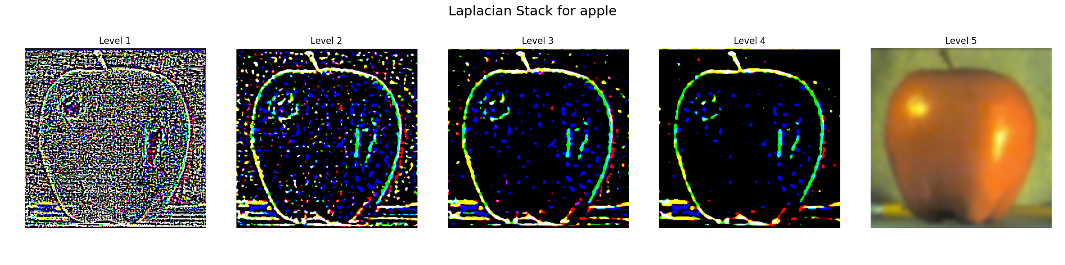
Part 2.3: Gaussian and Laplacian Stacks

Slide 31
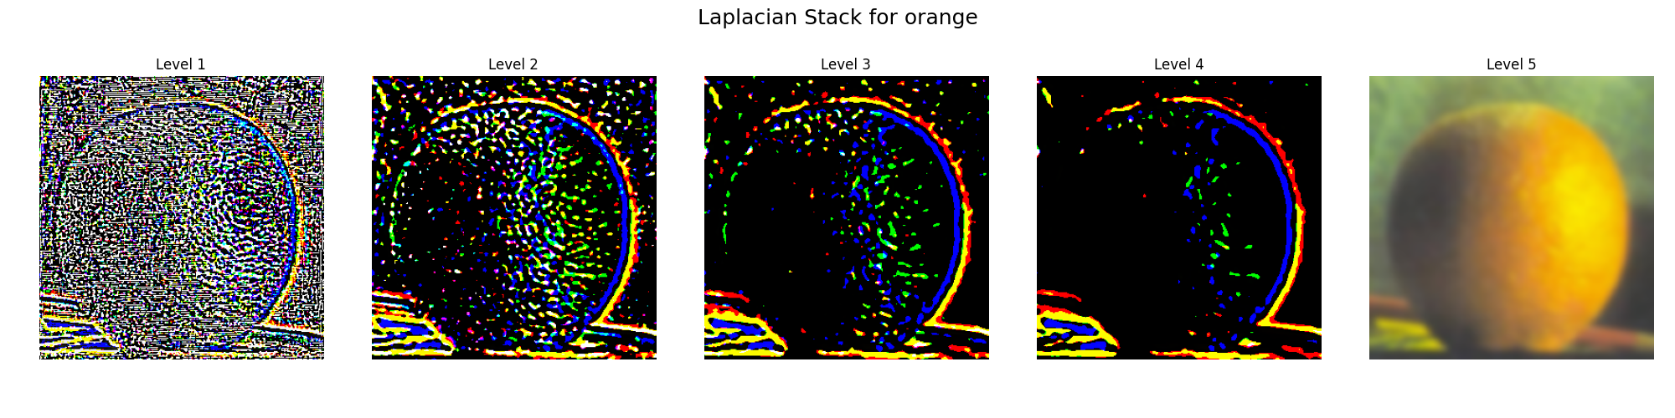
Part 2.4: Multiresolution Blending

Slide 32
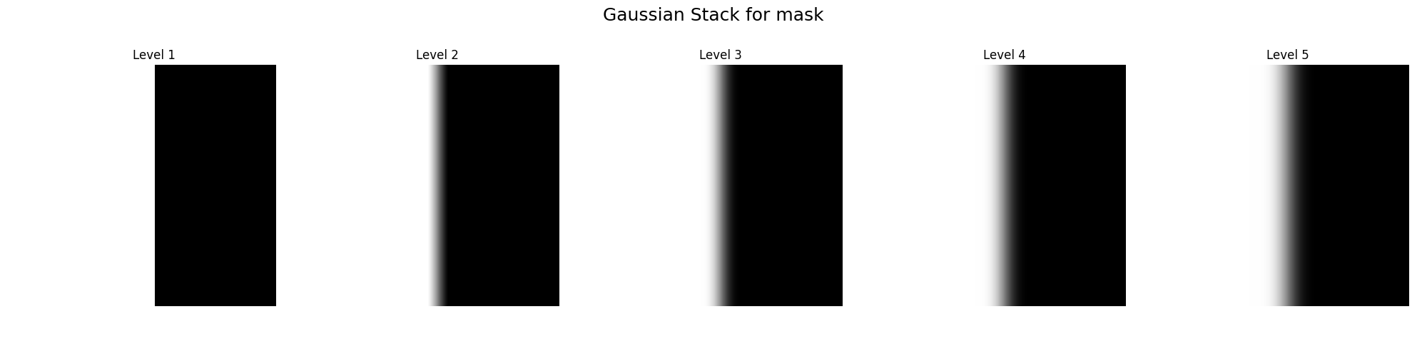
Part 2.4: Multiresolution Blending

Slide 33
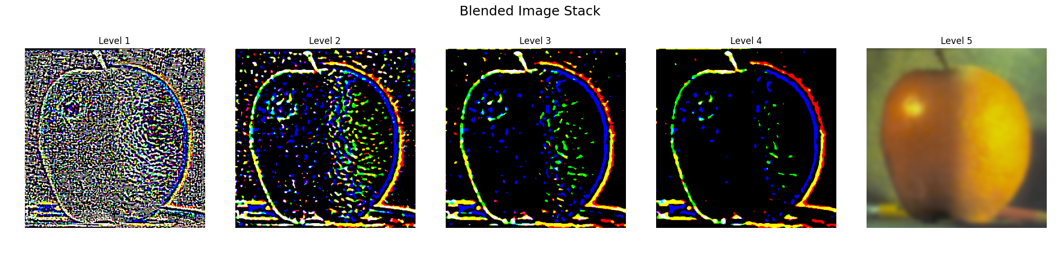
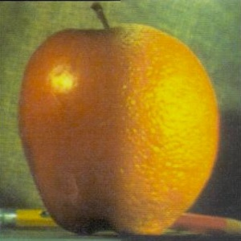
Part 2.4: Multiresolution Blending
Result:

